Slide 1
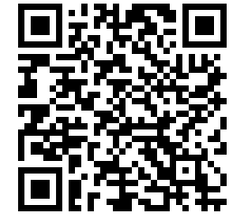


        Design Public Hearing for the Maple St. over I-495 Bridge Replacement
What is happening?
  The purpose of the Public Information Meeting is to provide the public with the opportunity to become fully acquainted with the preliminary design of the Bridge Replacement in Bellingham, MA. All views and comments made at the meeting will be reviewed to the maximum extent possible.
How will this affect you?
Currently, the bridge’s superstructure is in poor condition. This project will replace the bridge to meet today’s standards to maintain through-travel on Maple Street. To improve public safety, this project will widen the sidewalk on the bridge, install pedestrian access ramps, upgrade the guardrail, bridge curbing, bridge barriers, and provide bicycle accessibility with a six-foot wide shoulder on each side of the roadway.
When
Thursday, March 20, 2025
7 PM
Where
Bellingham Town Hall
Upper Level of the Arcand Meeting Room
10 Mechanic Street
Bellingham, MA, 02019
        Visit www.mass.gov/orgs/highway-division/events for more information.
To ensure its meetings are accessible, MassDOT reasonably provides: translation, interpretation, modifications, accommodations, alternative formats, and auxiliary aids and services. To request such services, please contact MassDOT’s Chief Diversity and Civil Rights Officer at 857-368-8580 or MassDOT.CivilRights@dot.state.ma.us. For adequate time to process such request, please make them as early as possible, ideally 10-15 days prior to the event.
Project inquiries may also be emailed to MassDOTProjectManagement@dot.state.ma.us. Please submit any written statements regarding the proposed undertaking to: Carrie A. Lavallee, P.E., Chief Engineer, MassDOT, 10 Park Plaza, Boston, MA 02116, Attention: PROJECT MANAGEMENT, PROJECT FILE NO. 612173

